Slide 1




















MATHEMATICS
ADDING
SUBTRACTING
by:
ADDITION AND SUBTRACTION

Slide 2


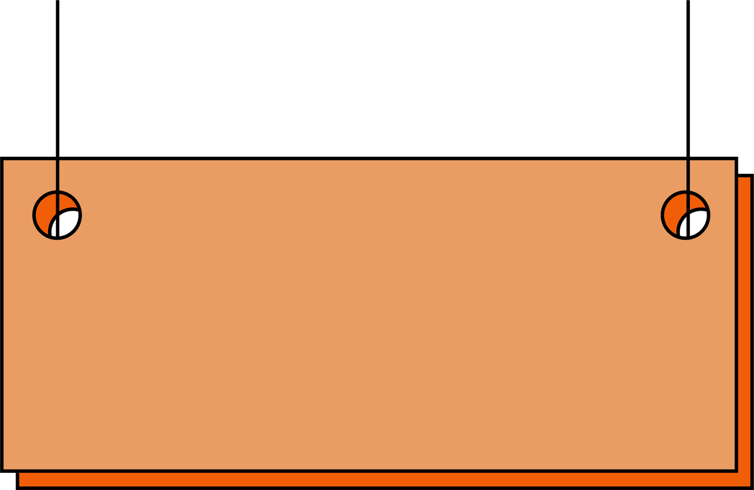




What is Addition?
Quiz:
DEFINITION:
SYMBOL:
6 + 7 = ?
Addition is combining
numbers to find the total.
8 + 8= ?
5 + 7= ?
9 + 7= ?
EXAMPLE:
5 + 4= ?
EXPLANATION:
2 apples + 1 apple is equals
to 3 apples

Slide 3


What is Subtraction?
Quiz:
DEFINITION:
SYMBOL:
9 - 5 = ?
Subtraction is taking
away numbers from a total.
7 - 4= ?
9 - 7= ?
10 - 5= ?
EXAMPLE:
5 - 4= ?
EXPLANATION:
3 mangoes - 2 mangoes is
equals to 1 mango

Slide 4



NOW LET’S COMBINE!
Quiz:
TIP:
SYMBOLS:
12 - 5 + 6= ?
Solve left to right for
simple problems
5 - 4 + 1= ?
9 - 7 + 5= ?
10 + 8 - 5= ?
EXAMPLE:
8 - 4 + 9= ?
EXPLANATION:
4 pears plus 2 = 6 pears
6pears - 5 = 1 pear

Slide 5



PRACTICE QUESTIONS
Addition:
Subtraction:
Combined:
10 + 9 =
10 - 9 =
10 + 9 - 10 =
22 + 5 =
15 - 5 =
14 - 5 + 2=
6 + 7 =
17 - 7 =
22 + 9 - 7 =
13 + 4 =
16 - 5 =
22 + 9 - 7=
33 + 9 =
13 - 9 =
1 + 9 - 5 =
50 + 9 =
11 - 9 =
33 - 9 + 10=

Slide 6






SUMMARY/ KEY TAKEAWAYS
Addition:
Addition:
Addition:
combining numbers (+)
Addition:
Addition:
Subtraction:
taking away numbers (−)
Addition:
Addition:
Combined:
combining and taking away numbers
(+) (-)

Slide 7

MATHEMATICS
ADDING
SUBTRACTING
by:
made with Nonex
ADDITION AND SUBTRACTION
Want affordable and quality presentations?
Find it in Nonex
https://nonex.onrender.com

